Slide 1
A critical analysis of deployed use cases for quantum key distribution and comparison with post-quantum cryptography
EPJ Quantum Technology 12, 51 (2025)
Nick Aquina, Bruno Cimoli, Soumya Das, Kathrin Hövelmanns, Fiona Johanna Weber, Chigo Okonkwo, Simon Rommel, Boris Škorić, Idelfonso Tafur Monroy, Sebastian Verschoor

Slide 2
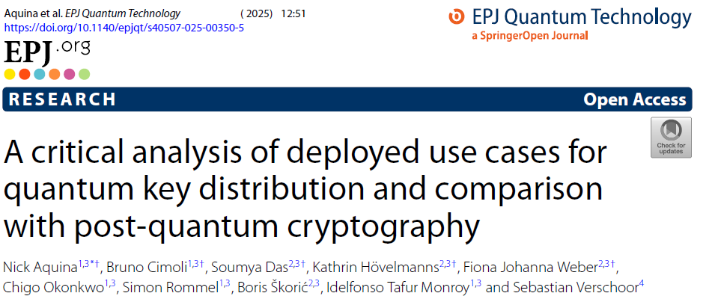
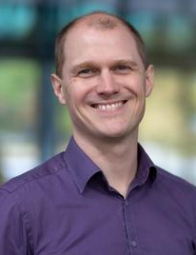
Team
14 use cases in 8 countries
Result of collaboration between QKD researchers and PQC researchers
Soumya Das
Sebastian Verschoor
Chigo Okonkwo
Simon Rommel
Idelfonso Tafur Monroy
Nick Aquina
Kathrin Hövelmanns
Bruno Cimoli
Fiona Weber
Boris Škorić

Slide 3
Table of Contents
Motivation and Contributions
Security Properties, Cryptographic Schemes Compared
Assumptions Comparison of QKD and PQC
Use Case Analysis Framework
Selected Use Case Summaries
Comparative Insights
Recommendations and Conclusions

Slide 4
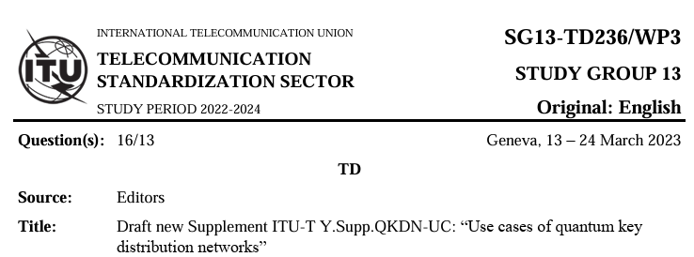
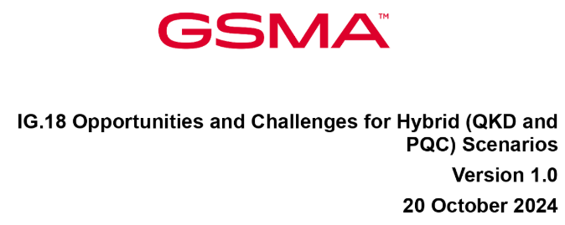
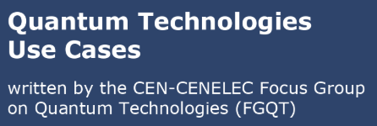
Motivation and Contributions
Our observations
1. Description only, no concrete security goal
2. No comparison with PQC
3. Some are only theoretical

Slide 5
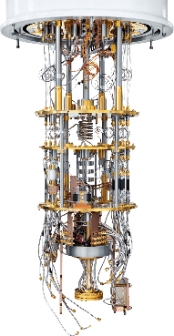
Harvest now, decrypt later
store
retrieve
time
today
2030? 2050? 2100?

Slide 6
Background
Classifying security
Cryptographic Primitives
Security guarantees
Comparison
Assumptions
Communication protocols

Slide 7
Classifying Security
Security
Eve is computationally unbounded
Eve is computationally bounded
Information Theoretic (ITS)
Computational
Eve succeeds with probability 0
Eve succeeds with probability ε
Eve has a quantum computer
Eve has (only) a classical computer
Perfect
Statistical
Post Quantum
Classical
One-time pad
ITS-MAC
ML-KEM, ML-DSA, SLH-DSA, AES, SHA3
RSA, (EC)DH, (EC)-DSA
QKD
Notes:
(Usually) ITS comes with absolute security proofs.
(Usually) PQC comes with relative security proofs: this primitive is secure if this problem is hard. ITS schemes have to discard keys after having used them.

Slide 8
Cryptographic Primitives
Symmetric cryptography
Encryption
Authentication (MAC)
Pseudo-Random Generator (PRG)
Asymmetric cryptography
(Authenticated) Key Exchange
Digital Signatures
Quantum Key Distribution (QKD)

Slide 9
Encryption
One-Time Pad (OTP):
perfect security
key must be used only once
key is as long as the message
AES-CBC, AES-CTR, ChaCha20, ...
post-quantum security
re-use the same key
key is short
Notes:
Symmetric: Alice and Bob have the same key
Provides confidentiality: "Eve learns nothing about the message contents"

Slide 10
Message Authentication Code (MAC)
ITS-MAC (Wegman-Carter):
statistical security
key must be used only once (one-time MAC)
key is short
HMAC, Poly1305-AES, ...
post-quantum security
re-use the same key
key is short
Notes:
Symmetric: Alice and Bob have the same key
Provides authenticity: "Eve cannot change the message contents or origin"

Slide 11
Authenticated Encryption
OTP + ITS-MAC:
statistical security
key must be used only once
AES-GCM, ChaCha20-Poly1305
post-quantum security
re-use the same key
Notes:
Symmetric: Alice and Bob have the same key
Provides confidentiality and authenticity

Slide 12
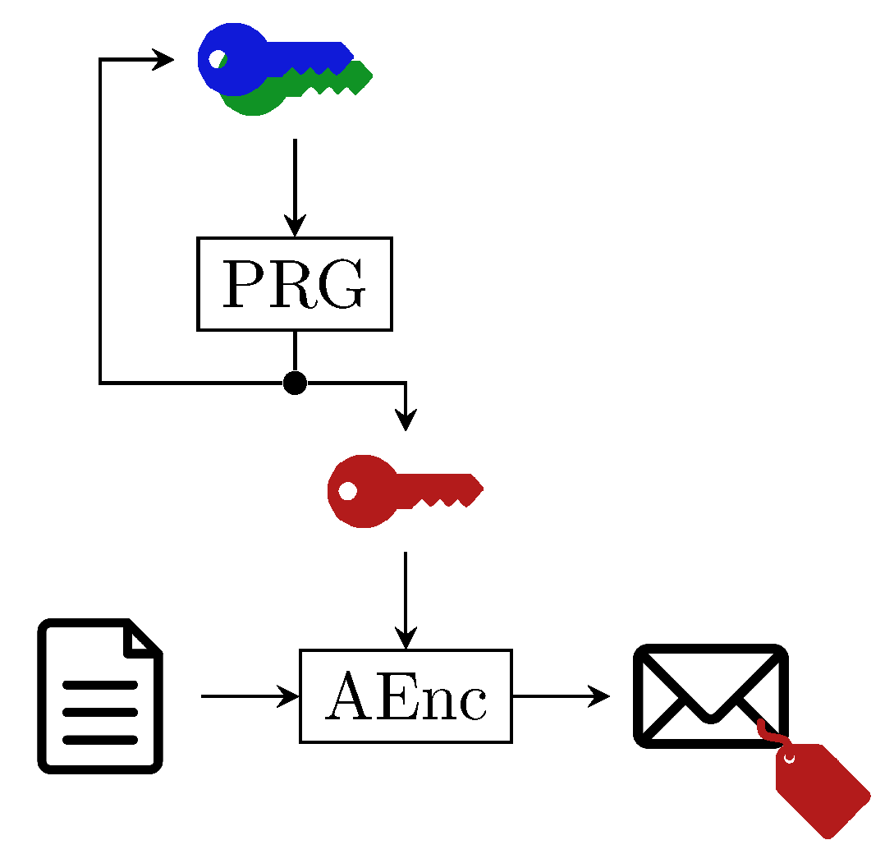
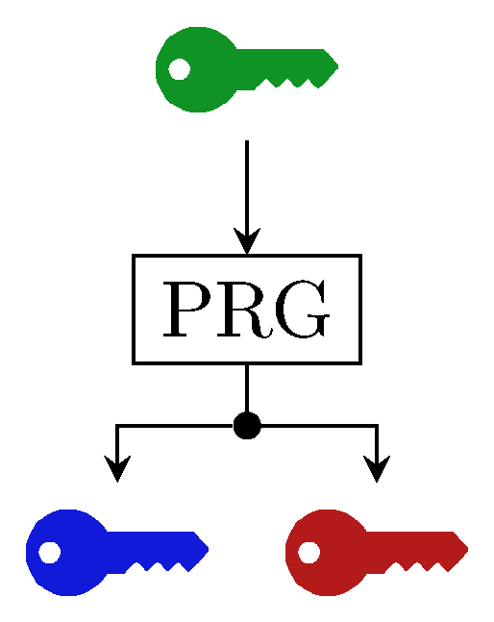
Pseudo-Random Generator (PRG)
Expand a small key into a larger one (or equivalently: multiple keys)
post-quantum secure
Can be used to build a symmetric ratchet:
replace used key with a new key
use remainder for data encryption
Notes:
A PRG can be built from symmetric crypto (AES) itself.

Slide 13
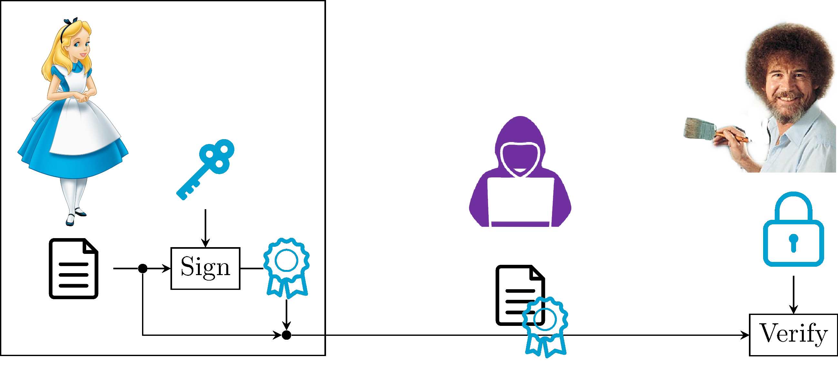
Digital Signatures
Asymmetric:
Alice's secret key
Alice's public key
ML-DSA, SLH-DSA
post-quantum security
Notes:
This looks a lot like a MAC, but we don't need shared keys.
Still Bob needs key authentication: a guarantee that the public key he holds indeed belongs to Alice

Slide 14
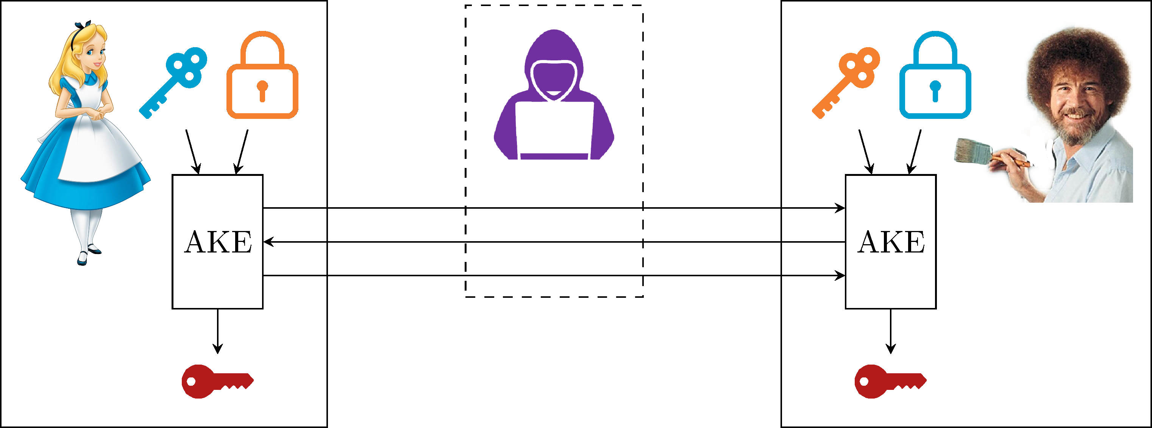
Authenticated Key Exchange (AKE)
Asymmetric:
Alice's keypair
Bob's keypair
post-quantum security
(Post-quantum) TLS, PQXDH (Signal)
Notes:
Again we need key authentication
TLS: uses a trusted root
Signal: requires out-of-band confirmation by its users

Slide 15
QKD (with ITS-MACs)
QKD for key expansion: use an ITS-MACs to authenticate post-processing
use a Pre-Shared Key for the initial QKD session
use part of the QKD output for subsequent QKD sessions
statistical security
Notes:
Different QKD protocols (BB84, Ek91, …) but they all require authentication

Slide 16
QKD (with Digital Signatures)
QKD for key exchange: use signatures to authenticate post-processing
use a public keypairs for the initial QKD session
post-quantum security
use part of the QKD output for subsequent QKD sessions
statistical security if the initial session was not broken

Slide 17
Assumptions of QKD
Quantum Theory is correct + complete
Quantum-information theoretic security
Secure implementations
Hardware does not leak information via side-channels
Hardware is "close enough" to ideal devices of the security proofs
Long-distance quantum channels
Quantum Repeaters (not ready for practical use)
Trusted Nodes (violates end-to-end principle)
Authenticated channel
Pre-Shared Keys; or
Key authentication

Slide 18
Assumptions of PQC
Underlying mathematical problem is hard
Assumptions on the difficulty of LWE
Assumptions on cryptographic hash functions
Assumptions on decoding errors
Assumption that AES acts pseudorandom
...
Secure Implementations
Remote side-channels
Local side-channels (with partial device access)
Key authentication
Public-Key Infrastructure (PKI); or
out-of-band key confirmation

Slide 19
Security guarantees
(long-term) keys get compromised
No forward secrecy:
Forward secrecy: (key erasure)
Post-compromise security:
Everlasting secrecy:
insecure
insecure
time
(long-term) keys get compromised
secure
insecure
time
keys get compromised
next key is generated
insecure
secure
time
key is generated and used (assuming generation was secure)
secure
time
Notes:
Forward secrecy, also called the key-erasure property: we can erase keys after we used them. Depending on the context, this would also require erasure of the secure data (when key compromise = device compromise)
PCS after *unrestricted* compromise is not possible.
Everlasting secrecy protects against cryptanalytic advances, FS does not.

Slide 20
A system is as secure as its weakest link
QKD key (statistical security) + OTP (perfect security)
⇒ statistical secure encryption
QKD key (statistical security) + AES (PQC security)
⇒ post-quantum secure encryption
QKD key + AES
breaks if either QKD or AES breaks
AES ratchet + AES
breaks if AES breaks
Notes:
Include this only after we did the three questions (and explain what we mean when we say qkd+aes, or aesprg + aes)

Slide 21
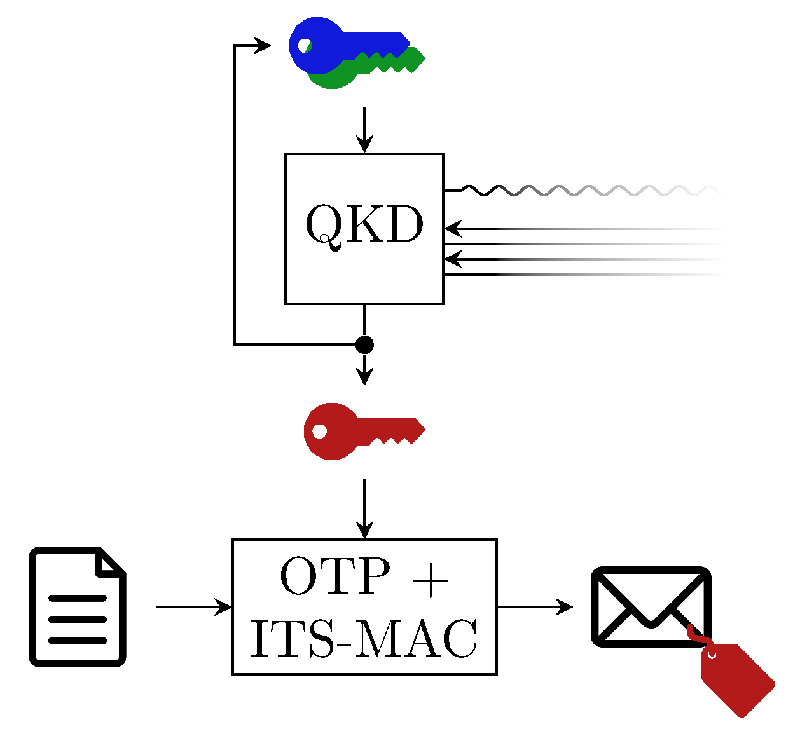
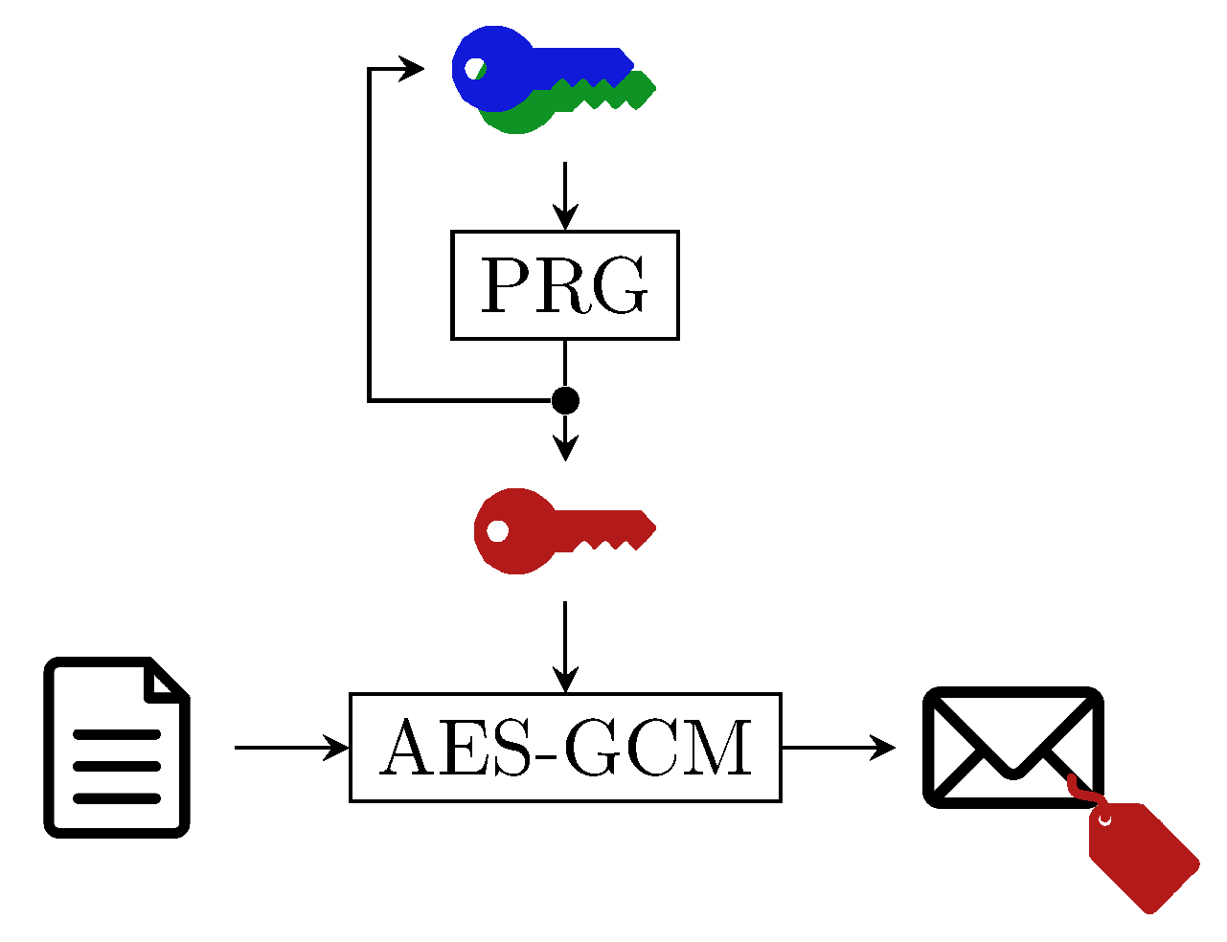
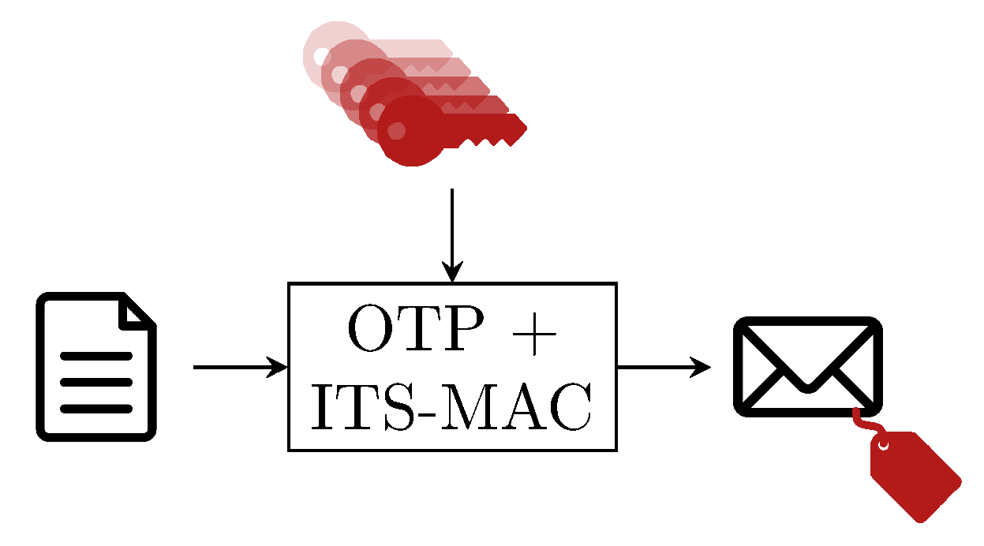
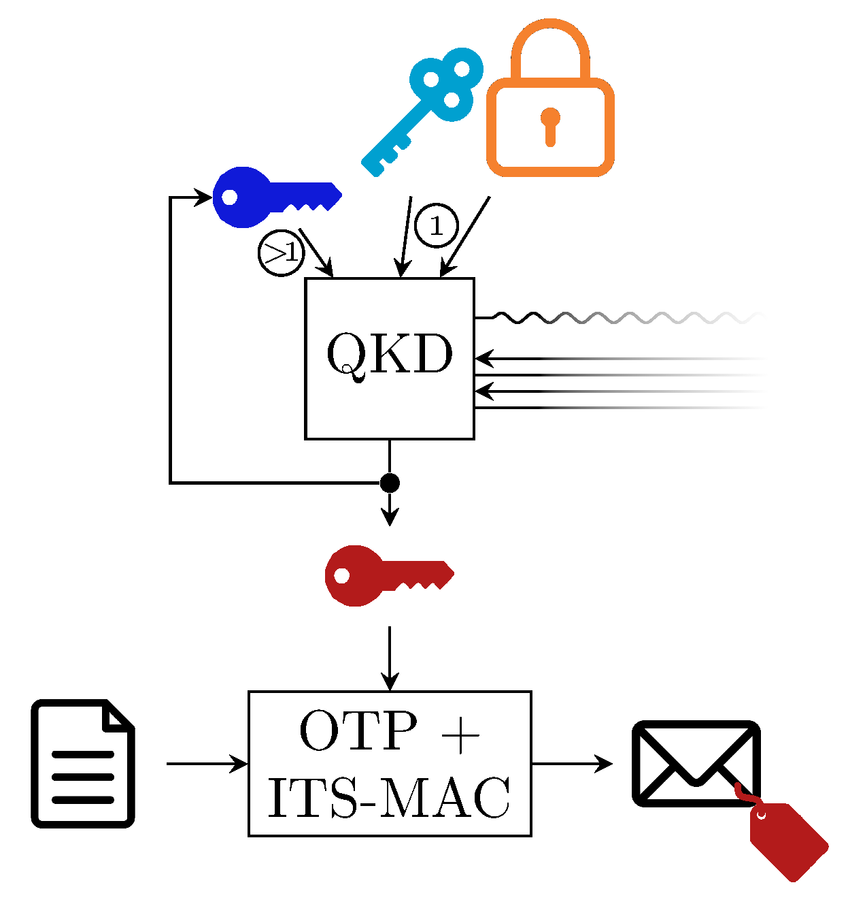
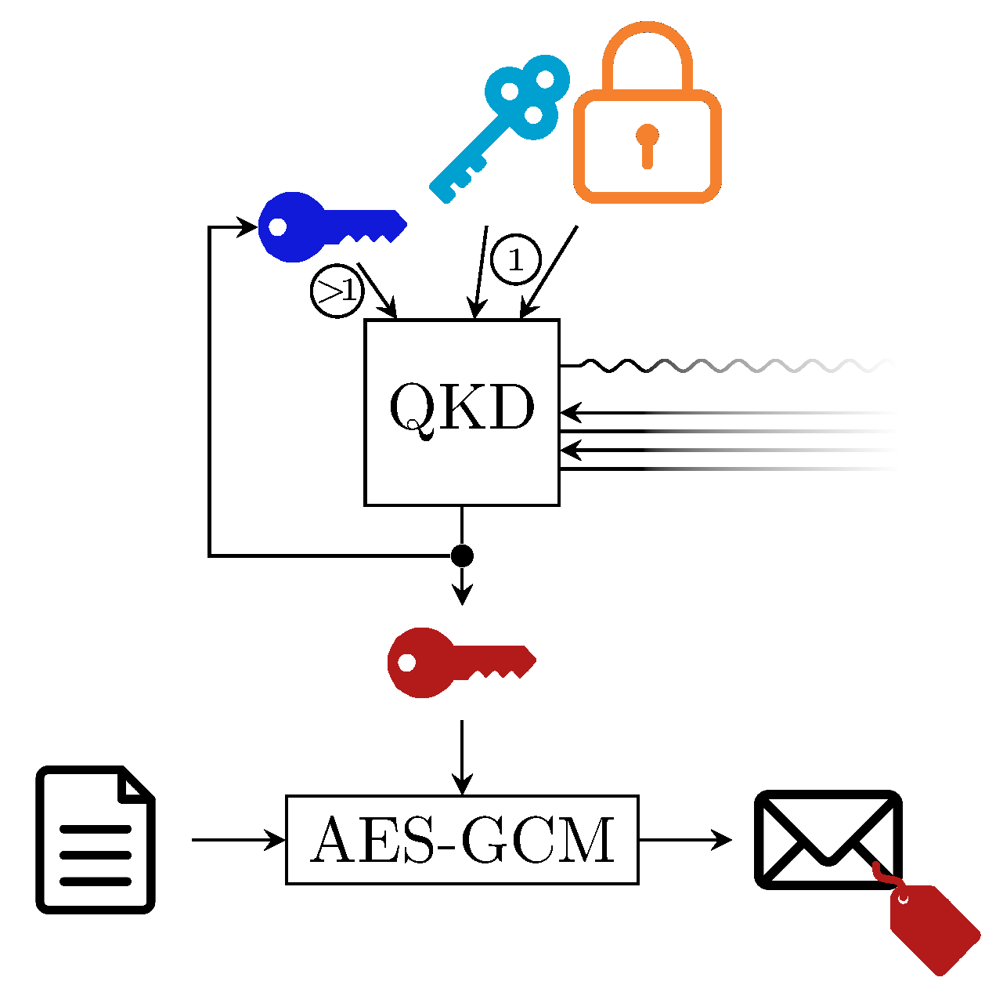
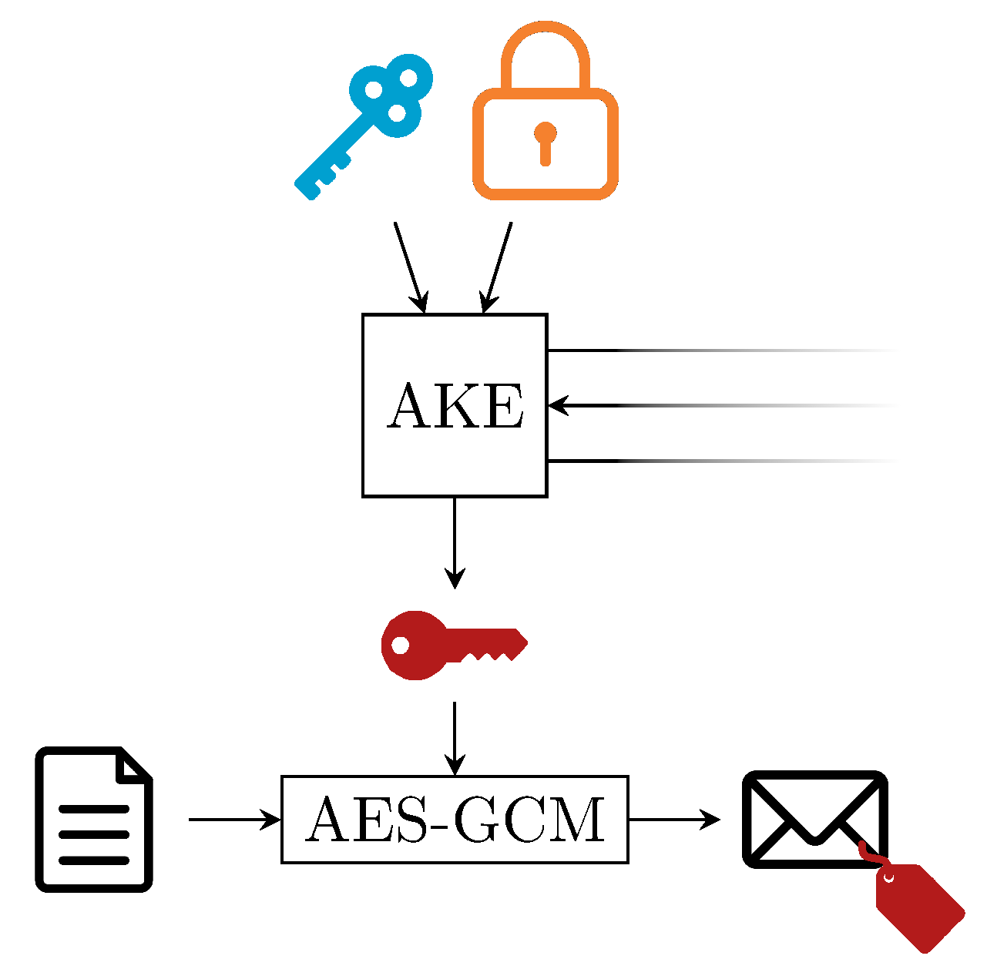
Protocols
3.1
3.2
3.3
3.4
3.5
3.6
Notes:
Numbered according to the sections of the paper. This is our own set of protocols, this is not what we saw in use-cases

Slide 22
Communication protocols
 | Key Establishment | Data encryption | Information Theoretic Security | Everlasting Secrecy | Forward Secrecy | Post-Compromise Security
3.1 | Pre-Shared Key | OTP + ITS-MAC | ✓ | ✓ | ✓ | x
3.2 | Pre-Shared Key + Ratchet | AES-GCM | x | x | ✓ | x
3.3 | QKD (with ITS-MACs) | OTP + ITS-MAC | ✓ | ✓ | ✓ | ✓
3.4 | QKD (with Signatures) | OTP + ITS-MAC | x | ✓ | ✓ | ✓
3.5 | QKD | AES-GCM | x | x | ✓ | ✓
3.6 | Post-quantum AKE | AES-GCM | x | x | ✓ | ✓

Slide 23
Analysis Method
QKD key usage
Network topology
Security guarantee
Which data is encrypted?
What is the key used for?
What kind of data will the key protect?
By which protocol is the key used?
Does it involve any additional cryptography?
How long does the data need to be protected?
What does the network topology look like?
What QKD protocols and devices are used?
What security guarantees does the system provide?
Confidentiality
Authenticity

Slide 24
Use Case Summaries
Authenticity of election results (2007)
Backup for disaster recovery (2017)
Financial data (2019)
Distributed information sharing and backups
Connecting data centers (2020)
Genome data (2020)
Metrics of an overbraider machine (2020)
Self-driving cars (2021)
Grid network (2022)
Authentication of smart grid communications (2022)
Genome distance sharing (2022)

Slide 25
Authenticity of election results
“… verify that the data has not been corrupted in transit …” - Ex State Chancellor Geneva
Central ballot counting station
Govt. Data Centers
HMAC-SHA-256
for authenticity
4km
QKD + AES-256 for confidentiality

Slide 26
Analysis and Recommendation
QKD not essential for aggregate results: Counting totals are transmitted after polls close, confidentiality isn't needed, only authenticity to prevent tampering.
Authenticated channels suffice: Since QKD requires an authenticated channel anyway, using that alone meets the security needs more naturally.
QKD added value in this use case is limited: Transmitting public, post-election data doesn’t benefit from QKD’s confidentiality guarantees.
Confidentiality becomes relevant only in a different setup:
If individual votes were transmitted in real time, confidentiality (and possibly QKD) would be needed, but this introduces new privacy
risks and attack vectors.

Slide 27
Distributed information sharing and backups
Facial recognition (2019): QKD-secured links protect biometric data and secret-shared backups to control server room access at Olympic facilities.
Key storage and key backup (2020): QKD-distributed keys enable OTP encryption of Shamir’s secret-shared blockchain keys for secure asset recovery.
Medical image sharing (2020): QKD keys encrypt AES-protected secret shares of medical images for secure dual-site analysis and fault-tolerant storage.
Medical record backup (2020): QKD secures AONT-split medical records sent to multiple data centers to ensure privacy and disaster recovery.

Slide 28
Discussion of Data Back-up Use case
Situation | Merit | Demerit | Recommended Solution
QKD used for transmitting backup data | Secure key exchange during transmission | Dynamic keys must be stored with the backup, reducing long-term security | Avoid using QKD for long-term backup protection; it's meant for transport security only
Encrypting data before transmission with a static/pre-existing key | No key storage needed at the backup site; easier to manage and audit | Requires upfront key management and distribution | Use long-term symmetric or asymmetric keys for encryption before sending to storage
Using asymmetric encryption for backup data | Data sender doesn't need to keep the secret key; improves operational separation | More complex key infrastructure; requires secure private key storage by decrypting party | Use public key for encryption and store private key securely in a separate, secure place
Applying secret sharing to backup decryption keys | Prevents single point of failure; requires collaboration to decrypt | Requires coordination and secure management of key shares | Distribute key shares to multiple trusted parties (e.g., board members) for joint access

Slide 29
Grid network: connecting power stations
“… secure data transmission and detect intrusions such as hackers taking control of the electricity distribution network …” – ID Quantique / Services Industriels de Genève
$$\left|+\right\rangle \left|1\right\rangle \left|−\right\rangle \left|0\right\rangle$$
010101010101

Slide 30
Analysis and Recommendation
Develop a clear threat model specifying data types, protection goals, and attacker profiles.
Focus on securing critical infrastructure against code execution and privilege escalation.
Consider PQC or conventional strong cryptography before QKD, unless long-term confidentiality is essential.
Avoid deploying QKD without a defined and justified security objective.

Slide 31
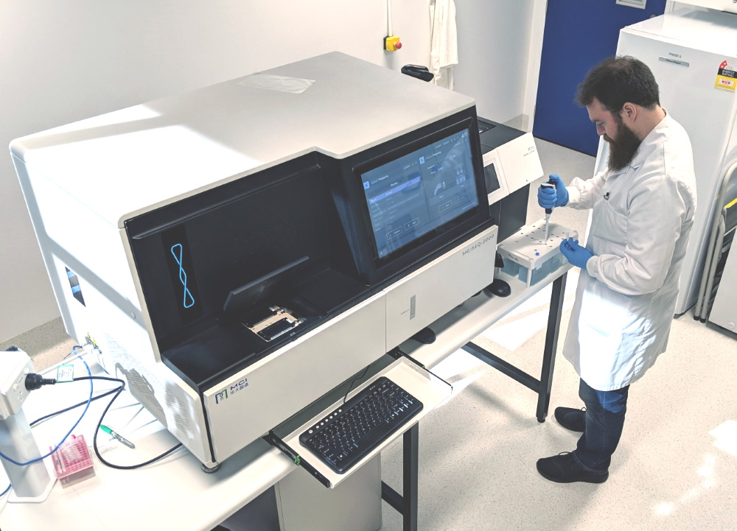
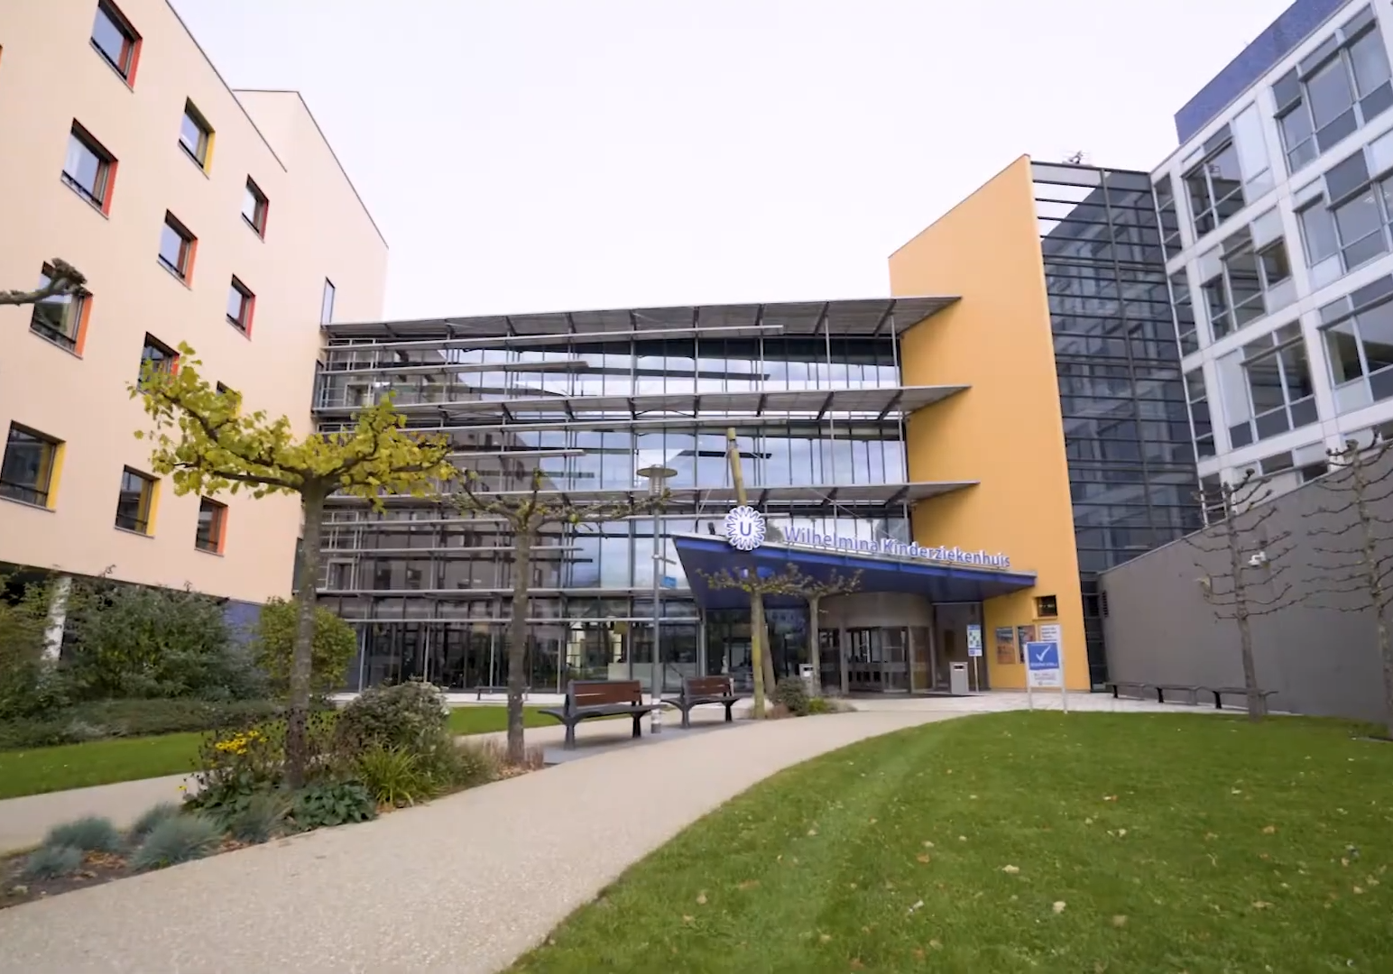
Genome data
“Secure the high-speed transfer of large-scale sensitive genome data between two remote sites” - Toshiba
$$\left|+\right\rangle \left|1\right\rangle \left|−\right\rangle \left|0\right\rangle$$
OTP encrypted genome data
Human genome analysis
University hospital

Slide 32
Analysis and Recommendation
Continue using OTP with QKD as it provides strong long-term confidentiality.
Explore physical pre-shared key alternatives for short-distance connections to reduce complexity.
Ensure proper authentication of OTP-encrypted data (missing in the current setup).
Periodically review the cost and practicality of maintaining QKD infrastructure.

Slide 33
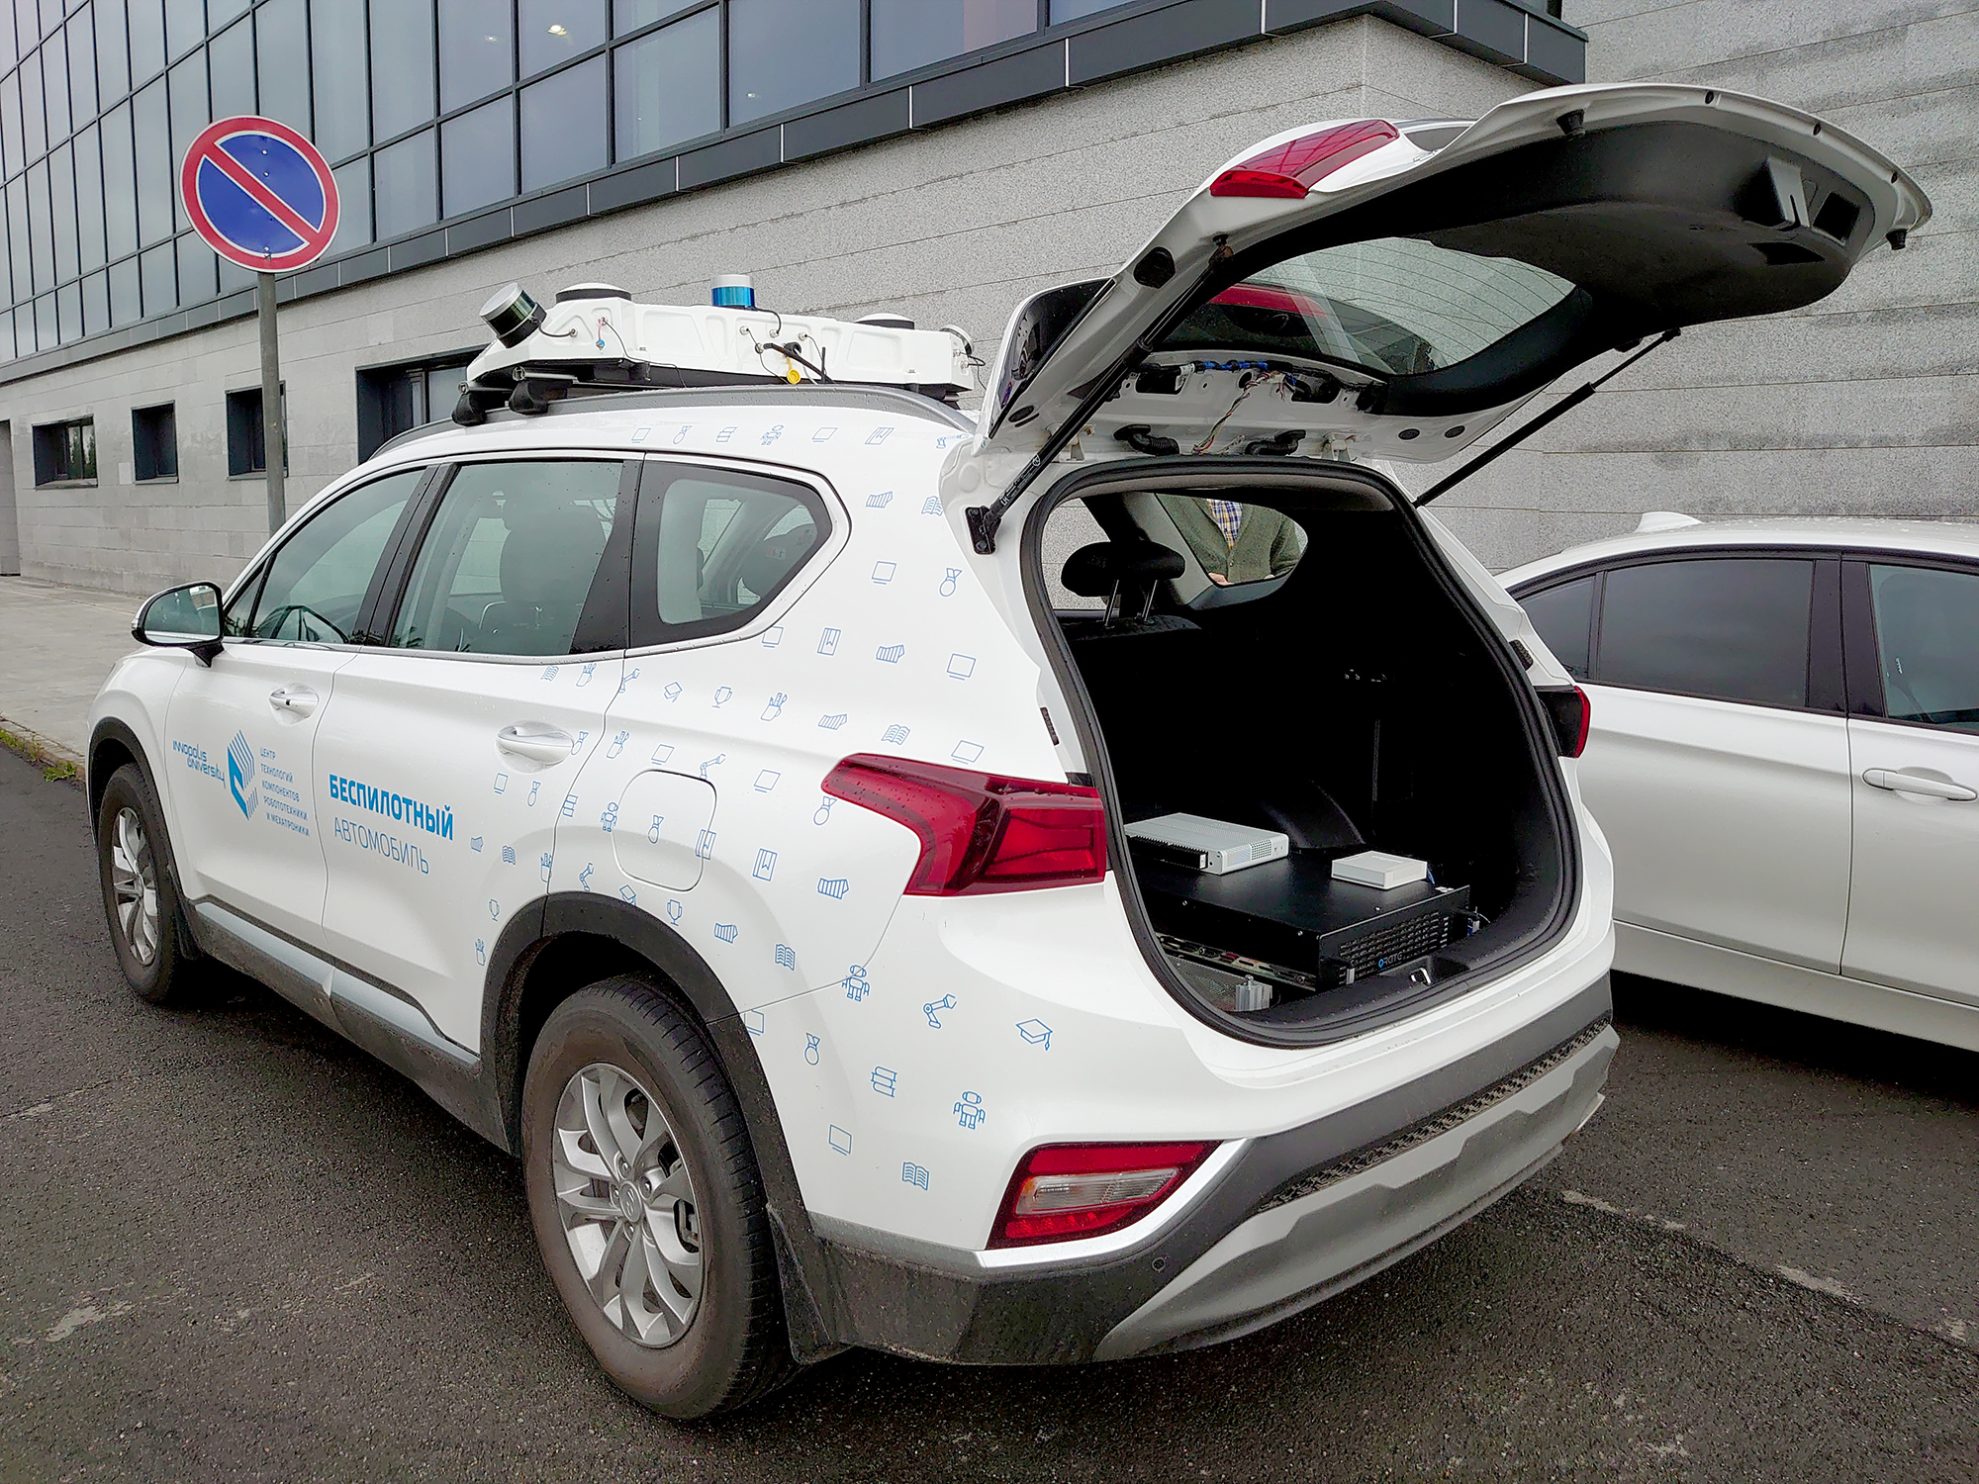
Self Driving Cars
Aim:
1. Secure software updates and real-time telemetry data of a self-driving car via encrypted communication.
2. Prevent unauthorized access or tampering during software updates delivered remotely.
Technology:
1. QRate QKD system (BB84 protocol) to generate key material at charging/refueling stations via optical fiber.
2.OpenVPN over 4G LTE using QKD-derived keys to protect telemetry data and update traffic.
3. Integration of QKD hardware in the vehicle for periodic key exchange at trusted locations.

Slide 34
Analysis and Recommendation
Use pre-shared keys for rental and privately owned cars, updated during regular maintenance.
Avoid QKD, as it adds complexity without clear security gain for this scenario.
Use existing authenticated channels directly for software updates rather than adding QKD.

Slide 35
Not considered use cases
More data needed to analyze
Limited use as a use-case
Critical Infrastructure Protection
e-Health services
Quantum Cryptography for B2B and 5G
Self-healed network management
Quantum Cryptography with minimal amount of QKD devices allowing independent
protection of users in collocated computing centers
Network security and attestation
QKD as a Cloud Service
Security independence of a network provider from QKD device manufacturers
Open Call KaaS

Slide 36
Conclusion and Recommendations
QKD vs. PQC: QKD offers theoretical security without computational assumptions, but comes with high cost, poor scalability, and limited practical use.
PQC is more practical: Easier to integrate into existing systems; addresses quantum threats effectively for most real-world needs.
Limited advantage for QKD: Only useful in niche cases—e.g., short-distance links using OTP for long-term confidentiality (like genome data sharing).
Decision point: Organizations must weigh trade-offs—QKD’s theoretical strength vs. PQC’s real-world adaptability and efficiency.

Slide 37
Acknowledgement and Funding
This work was in part funded by the Dutch Ministry of Economic Affairs and Climate Policy (EZK) as part of the Quantum Delta NL National Growth funds on Quantum Technology and by the NWO NWA project FIQCS (NWA.1436.20.005).
We thank the anonymous reviewers for their helpful comments on an earlier draft of the paper.

Slide 38
Reference Slides

Slide 39
Appendix: Quantum Authentication
Authentication of quantum messages: https://arxiv.org/pdf/quant-ph/0205128 (messages are quantum)
Quantum digital signatures: https://arxiv.org/abs/quant-ph/0105032v2 (public key is quantum)
Quantum Identity Authentication https://link.springer.com/article/10.1007/s11128-022-03717-0 Not sure why it is needed, given ITS-MACs exist. (Based on a misunderstanding? "Now, as the security of the classical authentication schemes is also based on the complexity of the computational task(s) involved, authentication using classical resources cannot be done in an unconditionally secure manner")
Something else?

Slide 40
Appendix: Combined keys
Combine multiple keys, so that Eve must break more than one key establishment
PQC + Classical
QKD + PQC
QKD + PQC + Classical
...
Many existing combiners use cryptographic hash functions
Not information theoretically secure
Used for ITS data encryption?

Slide 41
Backup for disaster recovery
Cerberis QKD devices to combine layer 2 Ethernet encryption using AES-256

